Slide 1

01
SOVEREIGN ENGINE / EVIDENCE–GEOMETRY CORE
Agreement without overclaiming.
2/3
Q0
A bounded local quorum protocol for reproducing a named Core Contract result—without turning majority agreement into physical truth.
WAVE Q0
OFFLINE FIXTURE PROFILE
2-OF-3
PROMOTION REQUIRES THE INVARIANT AND THE EVIDENCE TO SURVIVE.
Notes:
Welcome to Q0, our offline verification harness for the Sovereign Engine. We are here to establish agreement without overclaiming. Remember that Q0 is an offline deterministic verification harness, not production distributed consensus, and that finite fuzz results are implementation evidence rather than universal security proofs. Let us dive into why this layer exists.

Slide 2

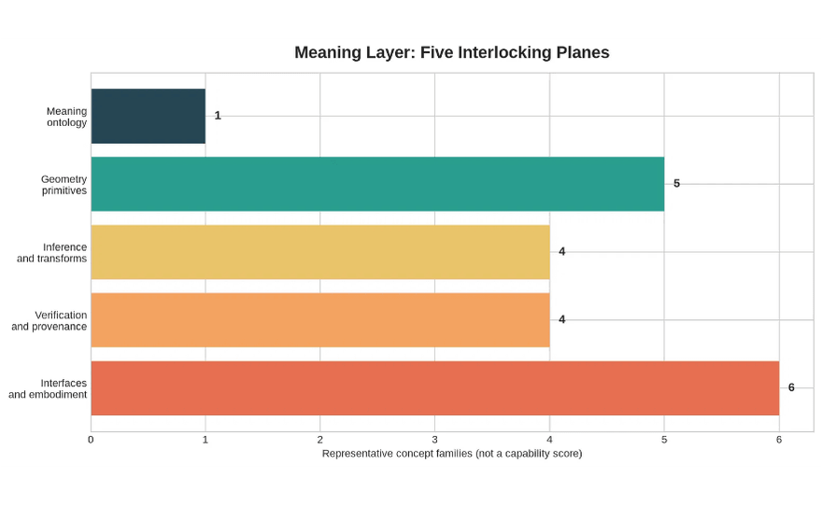
01 / MOTIVATION
Q0 · LOCAL VERIFICATION
THE PROBLEM IS NOT “MORE NODES.”
SOURCE SURFACE / CONTEXT ONLY
It is binding agreement to the same object.
A single evaluator can produce a deterministic result. A release process still needs evidence that distinct, policy-approved evaluator identities reproduced that result under the same contract, conventions, inputs, and output IDs.
THE QUORUM LAYER SITS BETWEEN
deterministic core and release evidence
01
02
03
Bind the request
Compare the result
Preserve dissent
Rule: agreement is evidence about reproducibility, not a physical-theory verdict.
Notes:
The core problem is not more nodes; it is binding agreement to the same object. While a single evaluator produces a deterministic result, a release process needs evidence that distinct, policy-approved evaluator identities reproduced that result under the exact same contract. Notice that agreement is evidence about reproducibility, not a physical-theory verdict. This local verification layer sits squarely between the deterministic core and the release evidence. Let us look at the protocol boundary that keeps this surface narrow and auditable.

Slide 3

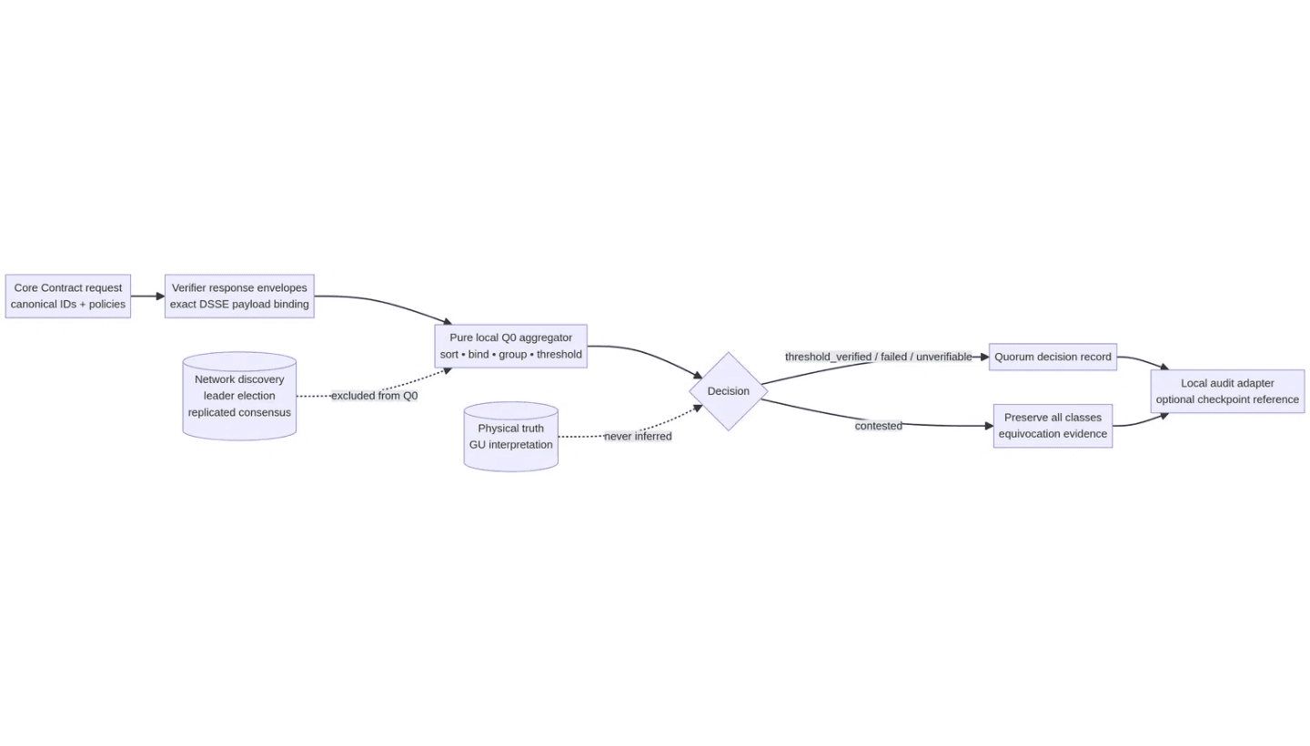
02 / BOUNDARY
THE LOCAL SURFACE IS THE TRUST SURFACE
Q0 OWNS
A narrow question, answered audibly.
CORE
Exact request, contract, conventions, policies, and result IDs.
DSSE
Exact payload bytes, supported type, and fixture key policy.
GROUP
Compatibility classes, thresholds, conflicts, and limitations.
OUTSIDE Q0: network discovery, leader election, replicated storage, liveness, tokens, and physical interpretation.
FIG 01 · AGREEMENT EVIDENCE FLOWS INTO AUDIT; IT NEVER MUTATES THE CORE VERDICT.
Notes:
The local surface is our trust surface, and agreement evidence flows strictly into audit without ever mutating the core verdict. Q0 owns a narrow, auditable question across core execution, DSSE packaging, and group compatibility classes. Everything else, from network discovery and leader election to tokens and physical interpretation, stays outside Q0. To understand how we track this, we need to inspect the six records of the Q0 object model.

Slide 4

03 / OBJECT ALGEBRA
IMMUTABLE RECORDS · Q0 v0.1
SIX RECORDS. ONE BINDING CHAIN.
The quorum layer does not replace the core.
01
verification_request
operation · ordered inputs · conventions · scalar/tolerance profiles · contract release
quorum:sha256 exact bytes bind every response
02
verifier_identity
node ID · active key ID · software release · environment class · policy membership
counts once per active policy identity
03
verifier_response
core status · output IDs · predicate results · scope · evaluator release
DSSE payload binds exact serialized bytes
04
quorum_policy
candidate keys · threshold · compatibility rules · validity/revocation · diversity
policy:sha256 immutable and versioned
05
quorum_decision
accepted/rejected IDs · equivalence classes · decision status · limitations
derived identity never mutates responses
06
equivocation_evidence
same signer/request · incompatible signed responses · preserved competing artifacts
critical signal contested; no auto-winner
CORE STATUS REMAINS verified / fail / unverifiable
AGREEMENT IS EVIDENCE · NOT PHYSICAL TRUTH
Notes:
Six immutable records form a single binding chain, proving that the quorum layer does not replace the core. From verification requests and verifier identities to responses, policies, decisions, and equivocation evidence, every piece is tracked. The core status remains verified, fail, or unverifiable, because agreement is evidence rather than physical truth. Now, let us examine how these records feed into our deterministic decision function.

Slide 5

03 / DECISION FUNCTION
PURE · ORDERED · FAIL-CLOSED
The same evidence must produce the same decision.
Q0 does not vote by arrival order. It binds, sorts, groups, and applies the declared threshold to immutable response identities.
01 / BIND
02 / ORDER
03 / GROUP
04 / THRESHOLD
Exact request
Stable sort
Equivalence key
Policy result
→
→
→
request_id · contract · operation · convention · scalar/tolerance policy
candidate responses ordered by active key_id, then response_id
status · output IDs · reason class · verification scope
count unique active identities; preserve rejected and conflicting evidence
equivalence = (request, contract, operation, predicate, convention, scalar, tolerance, status, outputs, reasons, scope)
AGREEMENT
LIMITATION
CONFLICT / REJECTION
threshold_verified
t verified
threshold_unverifiable
common gap
contested
preserve classes
threshold_failed
t failed
insufficient_quorum
not enough
rejected_response
exclude + retain
Important: a threshold reproduces a named core result; it does not upgrade that result into physical truth.
Notes:
The same evidence must always produce the same decision through a pure, ordered, and fail-closed process. Q0 doesn't vote by arrival order; it binds, stably sorts, groups, and applies declared thresholds to immutable response identities. Notice that achieving threshold verification reproduces a named core result, but it never upgrades that result into physical truth. As we transition to examine offline fixtures and DSSE binding, we keep these strict operational boundaries intact.

Slide 6

05 / CRYPTOGRAPHIC BINDING
OFFLINE FIXTURE PROFILE · HMAC ONLY
SIGNED RESPONSE FIXTURE
Same bytes. Same policy. Same identity.
The key hint is never the trust decision. The policy selects the active identity.
01 / TYPE
02 / BYTES
03 / PAE
04 / KEY
05 / COUNT
Named payload
Canonical body
DSSE binding
Policy check
One identity
Exact schema + encoding. Generic JSON is rejected.
JCS-compatible bytes. No mutable metadata.
Payload type + bytes enter pre-auth encoding.
Active key, node, release, validity and revocation.
Duplicate key counts once. Conflicting bytes = evidence.
ACCEPTED ONLY IF
✓
Request binding survives
FIXTURE BOUNDARY
request_id, contract, operation, convention, scalar, tolerance, and policy all
This is not production signing.
match.
✓
Payload bytes verify exactly
signature covers the bytes that the application parses; altered bytes cannot be
Q0 uses HMAC-SHA256 fixtures only to exercise exact payload binding. Public-key selection, rotation, revocation, custody, compromise recovery, and algorithm approval remain separate security gates.
normalized into acceptance.
✓
Identity remains distinct
two labels or node aliases cannot manufacture independent verifier evidence from one
active key.
OFFLINE / NO KEY CUSTODY
Notes:
Moving from high-level decision logic into the cryptographic mechanics, we need to inspect how Q0 handles offline DSSE binding and key-policy fixtures. Notice that this harness uses HMAC-SHA256 fixtures strictly to test exact payload binding, keeping it separate from production key custody or rotation concerns. Every byte must be canonically formatted using JCS-compatible encoding, meaning mutable metadata is stripped away before the pre-auth encoding step. And because our identity checks enforce that duplicate keys count only once, any conflicting bytes immediately generate inspectable failure evidence. Moving forward, we need to see how the system behaves when these cryptographic bounds are actively challenged by malicious inputs.

Slide 7

05 / ADVERSARIAL MATRIX
PRESERVE DISSENT · NEVER MANUFACTURE AGREEMENT
SCENARIO
SIGNAL
REQUIRED BEHAVIOR
WHEN THE EVIDENCE DISAGREES
Duplicate identity
COUNT ONCE
Two responses from one active verifier identity cannot create two votes. Preserve the duplicate evidence.
Preserve. Do not resolve.
Same-key equivocation
CONTESTED
One key signs incompatible outputs for one request. Emit equivocation evidence and block a clean decision.
Q0 treats disagreement as a first-class outcome. Identity aliases count once. Conflicting signed responses remain inspectable. Thresholds do not silently fall when a node disappears.
Output divergence
NO MERGE
Same status, different output IDs, or incompatible residual class. Group separately; never merge by explanation text.
Stale or revoked key
REJECT
Inactive policy identity is excluded. Do not lower the threshold to compensate.
Request mismatch
REJECT
Wrong request, contract, convention, or payload type. Return a typed rejection and retain the envelope.
Operating rule No arrival-order winner. No text-only equivalence. No key hint as a trust decision.
Insufficient quorum
AVAILABILITY
Fewer than t eligible identities before the policy boundary. Availability limitation, not mathematical failure.
Q0 STATUS VOCABULARY: THRESHOLD_VERIFIED · THRESHOLD_FAILED · THRESHOLD_UNVERIFIABLE · CONTESTED · INSUFFICIENT_QUORUM · REJECTED_RESPONSE
Notes:
Building directly on our deterministic DSSE fixtures, we now confront how the Sovereign Engine handles active adversarial dissent. The core operating rule here is simple: when evidence disagrees, we preserve the disagreement rather than forcing a synthetic consensus. If a single key signs conflicting outputs for the same request, the system flags it as contested rather than trying to guess the correct winner. We never lower our verification thresholds just because a node drops out or an identity turns out to be stale. By treating status vocabulary items like threshold failed or contested as first-class outcomes, we ensure the audit trail remains completely honest. And that exact discipline is what drives our rigorous fuzz campaign design.

Slide 8

07 / ADVERSARIAL CONFIDENCE
FUZZ CAMPAIGN DESIGN · FIXED SEEDS
CAMPAIGN
TARGET LANES / WHAT CAN BREAK
ORACLE HIERARCHY
10k +
Fail closed by construction.
R1
Canonical bytes
Key permutations, Unicode, integer boundaries, raw floats, deep values.
01
Exact canonical bytes: Python reference and Rust output match.
R2
Derived identity
generated cases across the shared Rust/Python domain before the extended campaign is admitted.
Mutation pairs, accepted-body ID stability, implementation-induced collisions.
02
Contract oracle: invalid, failed, or unverifiable is explicit.
R3
Invariant interpreter
03
Metamorphic oracle: key order, replay, and idempotence properties.
Metric matrices, sparse tensors, malformed references, unknown operations.
04
No oracle: never promote unsupported behavior to verified.
SEEDS / 03
P1
Durable replay
R1 · R2 · P1 recorded, replayable, never “random” in CI.
Truncation, manifest drift, tampered bytes, path boundaries, idempotent re-put.
Promotion rule: a zero-collision corpus is evidence about this implementation—not a proof that SHA-256 has no collisions.
Notes:
Taking those adversarial behaviors into a structured testing environment, we rely on deterministic fuzz campaigns across fixed seeds to validate our implementation. We generate over ten thousand test cases spanning canonical bytes, derived identities, invariant interpreters, and durable replay lanes without ever trusting random runtime variance. Our oracle hierarchy fails closed by construction, demanding exact canonical byte parity between the Python reference and Rust output. But we must be precise about what this evidence means: a zero-collision corpus is robust implementation data for this specific codebase, not a universal proof that underlying cryptographic hashes are unbreakable. Which brings us directly to the empirical results of running this fuzz campaign at scale.

Slide 9

08 / CAMPAIGN RESULTS
SEED 0x51554F52554D5F51 · DETERMINISTIC RUN
ADVERSARIAL CASES
OBSERVED CAMPAIGN VOLUME
RESULT SIGNAL
5,750✓
Every lane returned the expected boundary.
Boundaries held.
MAX SCALE = 2,000 CASES · COUNTS ARE RECORDED TEST INPUTS
Across duplicate identity, equivocation, order, binding, signature, and invalid-policy lanes.
Equivocation stayed contested. Duplicate identities never manufactured extra votes. Response ordering did not alter the decision identity. Invalid policies failed closed.
equivocation
2,000
duplicate identity
1,650
0 unexplained failures
order permutation
1,000
0 cross-language ordering failures 0 accepted equivocation cases 0 duplicate-vote promotions
binding mutation
500
signature mutation
500
Interpretation: implementation evidence for Q0 v0.1. Not a proof of SHA-256 collision resistance, production consensus, key custody, or physical truth.
invalid policy
100
0
1,000
2,000
The campaign is deterministic and replayable. It tests the implemented Q0 fixture profile; it does not substitute for a security proof.
Notes:
Executing our deterministic seed across thousands of adversarial test cases gives us hard empirical boundaries on system behavior. Every single lane, from equivocation and duplicate identities to order permutations and invalid policies, returned the exact expected boundary without a single unexplained failure. Equivocation stayed contested, duplicate votes were blocked, and invalid policies failed closed across the board. But let's be entirely clear about the evidence boundary here: this is concrete implementation evidence for version zero-point-one of the Q0 harness, not a mathematical proof of production consensus or universal security. We have verified our specific protocol logic against a fixed corpus, establishing a rigorous foundation for everything that follows.

Slide 10

08 / EVIDENCE BOUNDARY
THE NEGATIVE SPACE IS PART OF THE RESULT
A PASSING CAMPAIGN IS NOT A UNIVERSAL PROOF
What survived. What remains open.
The correct conclusion is narrower than the ambition—and therefore more useful for the next gate.
ESTABLISHED BY THIS CAMPAIGN / IMPLEMENTATION EVIDENCE
NOT ESTABLISHED / FUTURE GATES REQUIRED
✓
Cross-language parity
Python and Rust matched canonical bytes, derived IDs, and bounded invariant outcomes over the shared corpus.
×
Production custody
No public-key lifecycle, hardware custody, revocation operations, or compromise recovery has been approved.
✓
Local tamper detection
Atomic storage, manifest replay, noncanonical-byte mutation, and path-boundary cases fail closed.
×
Byzantine consensus
No network liveness, leader election, replicated log, partition tolerance, or adversarial quorum guarantee.
✓
Q0 determinism
Stable ordering and equivalence grouping produce identical decisions for permuted response inputs.
×
Collision proof
Zero corpus collisions is evidence about this implementation and seed set—not a proof of SHA-256 security.
✓
Adversarial handling
Duplicate identities, same-key equivocation, stale keys, binding errors, and invalid policies are classified.
×
Physical truth
Quorum agreement does not validate a Geometric Unity interpretation or any physical-world claim.
RELEASE IMPLICATION
Advance the offline verification harness. Do not promote a distributed or physical-claim system.
QG4 / EVIDENCE PASSED QG5 / NOT YET ACCEPTED
Notes:
We have to be ruthless about what our testing actually establishes and where the boundaries lie. What we proved is strict cross-language parity, local tamper detection, clean determinism, and robust adversarial handling over our test corpus. But let's be entirely clear about what remains completely unproven. We have not established production key custody, Byzantine consensus, collision proofs for cryptographic primitives, or any physical truth claims about Geometric Unity. Finite fuzzing is never a universal security proof. And this exact negative space is what guides our release posture. We advance the offline verification harness, but we do not promote a distributed system or an unsupported physical theory. Let's look at the specific promotion gates that enforce this boundary next.

Slide 11

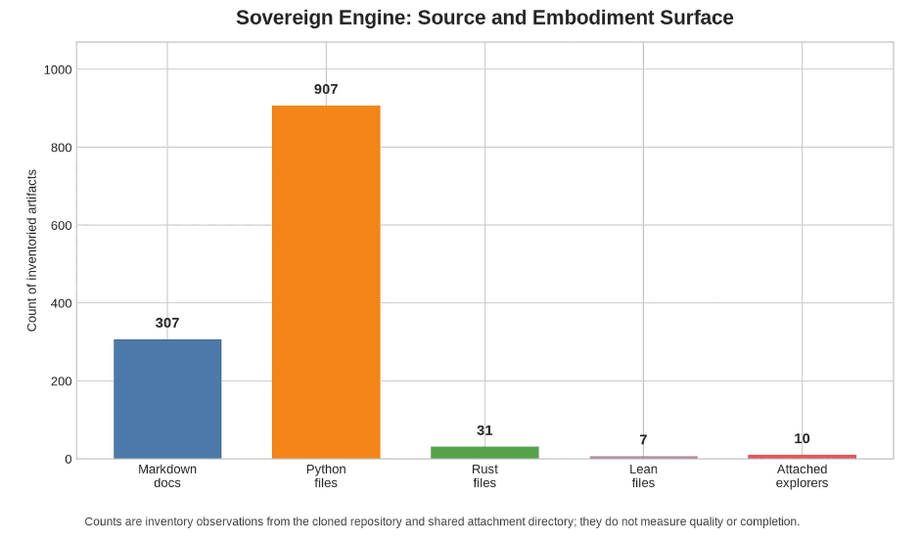
10 / PROMOTION CONTROL
QG1–QG5 · RELEASE IS EARNED
FIVE GATES BEFORE EXPANSION
EVIDENCE SPINE / REQUIRED ARTIFACT SURFACE
Evidence first. Promotion second.
Each gate closes a different failure mode. Passing one gate never implies that the next trust boundary is safe.
QG1
Semantic agreement
schemas + equivalence typed decisions are accepted
QG2
Cryptographic binding
DSSE + key policy exact payloads, revocation, identity rules
FIG 02 · THE GATES ARE ARTIFACT-GROUNDED: CODE, FIXTURES, REGISTRIES, AUDIT RECORDS, AND OPERATIONS POLICY MUST COHERE.
QG3
Audit integration
replay + checkpoints decisions reference immutable evidence
Until QG5 passes, Q0 stays offline.
QG4
Adversarial confidence
fuzz + property suite no unexplained collision or fail-open path
No network discovery. No production quorum. No key custody. No claim that agreement establishes physical truth.
QG5
Operational decision
security + ownership key lifecycle, incident, retention, rollback

Slide 12

11 / NEXT WAVE
Q0 → Q1 → Q2 · CONTINUE UNDER GATE
THE NEXT IMPLEMENTATION SEQUENCE
Keep the core ahead of the network.
Each step expands evidence capacity without changing the meaning of a verified Core Contract result.
01
02
03
04
05
Full parity
Local decisions
Key profiles
Audit bridge
Operational review
Rust fixture/error mapping, rational scalars, and every published invariant case.
Persist quorum requests, accepted/rejected responses, classes, and limitations.
Offline public-key DSSE fixtures, policy validity, revocation, and rotation cases.
Decision events reference immutable evidence, checkpoints, and replay proofs.
Threat model, key ownership, retention, incident, rollback, and security sign-off.
EXIT CROSS-LANGUAGE IDS + STATUSES MATCH
EXIT REOPEN + REPLAY IS DETERMINISTIC
EXIT BINDING + IDENTITY GATES PASS
EXIT EQUIVOCATION STAYS VISIBLE
EXIT QG5 DECISION RECORDED
BOUNDARY
Until QG5 passes: no network discovery, no production quorum, no key custody, no consensus claim, and no inference from agreement to physical truth.
Q0 COMPLETE NEXT: FULL PARITY THEN LOCAL DECISION RECORDS

